Slide 1
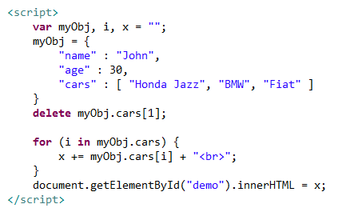
JSON Arrays – Delete an Item
We can use the delete keyword to delete items from an array.

